Slide 1
Kitsune
By VGDA SHINOBI

Slide 2
The Team
Matthew Berrios – Programmer
Maddie Powers Johnson – Programmer
Johnson Nguyen – Sound Design
Kenny Nguyen – Programmer
Chloe Pitko – Artist
Marcus Chiu – Programmer

Slide 3
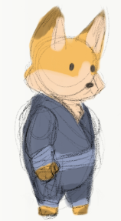
Lore
Kitsune is a ninja from the fox clan.
He comes back to find his village destroyed and learns that an enemy ninja clan seeks to steal an ancient artifact from their shrine.
Kitsune goes on a quest to stop the rival ninjas and get to the shrine before they do

Slide 4
Mechanics
The Game
Movement
2-D Sidescroller
Single Player
Platform/Puzzle/Shooter
Normal Left, Right, and Jump movement
Teleportation Shuriken
Normal Damage Shuriken
Kunai with Rope

Slide 5
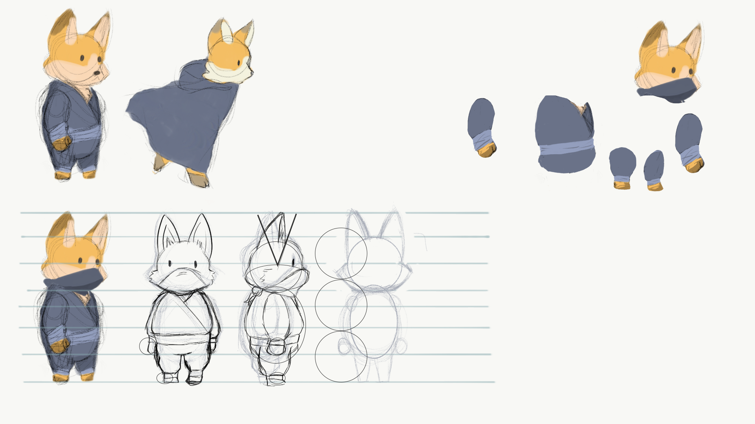
Concept Art

Slide 6
Prototype Demo

Slide 7
Thank You

